Slide 1
Case Study
E02 Continuous Diffusion of Oxygen
Kathy Mutch
BN, RN, NSWOC, WOCC(C)

Slide 2
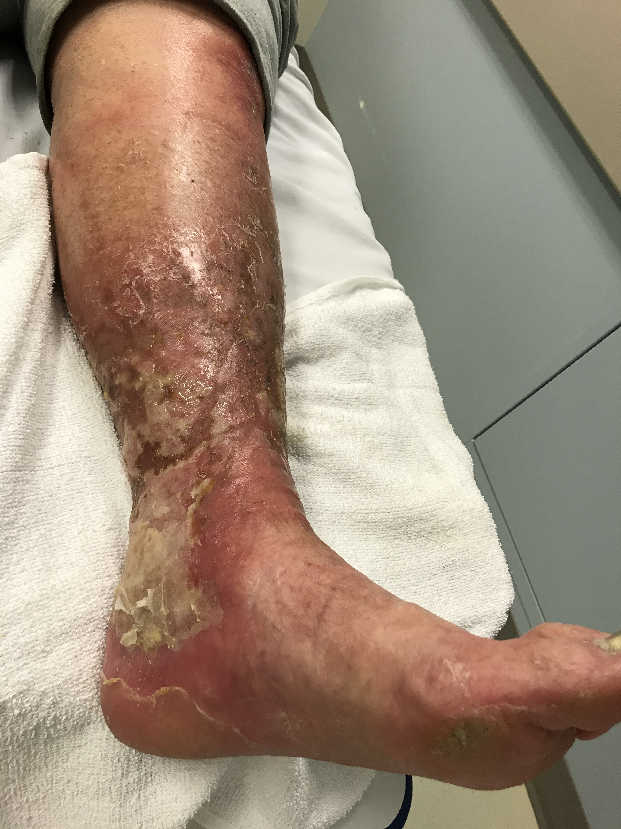
Case Study: Painful lower leg ulcer
69 year old male presented at the wound clinic on March 11 2020
He noticed a black spot on his leg in January which did not improve

Slide 3
Case Study: Painful lower leg ulcer
March 11 2020
Assessment:
Assessed by vascular surgeon and wound nurse
Findings
Painful lesion noticed on left medial leg sometime in January
Wound size 35.75 sqcms
Wound started as “a black dot”
Bilateral superficial varicosities
Stasis dermatitis
Bilateral lower limb edema
ABPI - 1.27 bilaterally
Treatment Plan
Cephalexin 500mg bid
Wound debridement
Antimicrobial Silver gel and absorptive topper dressing
Compression stockings
To be Reassessed March 28, April 2

Slide 4
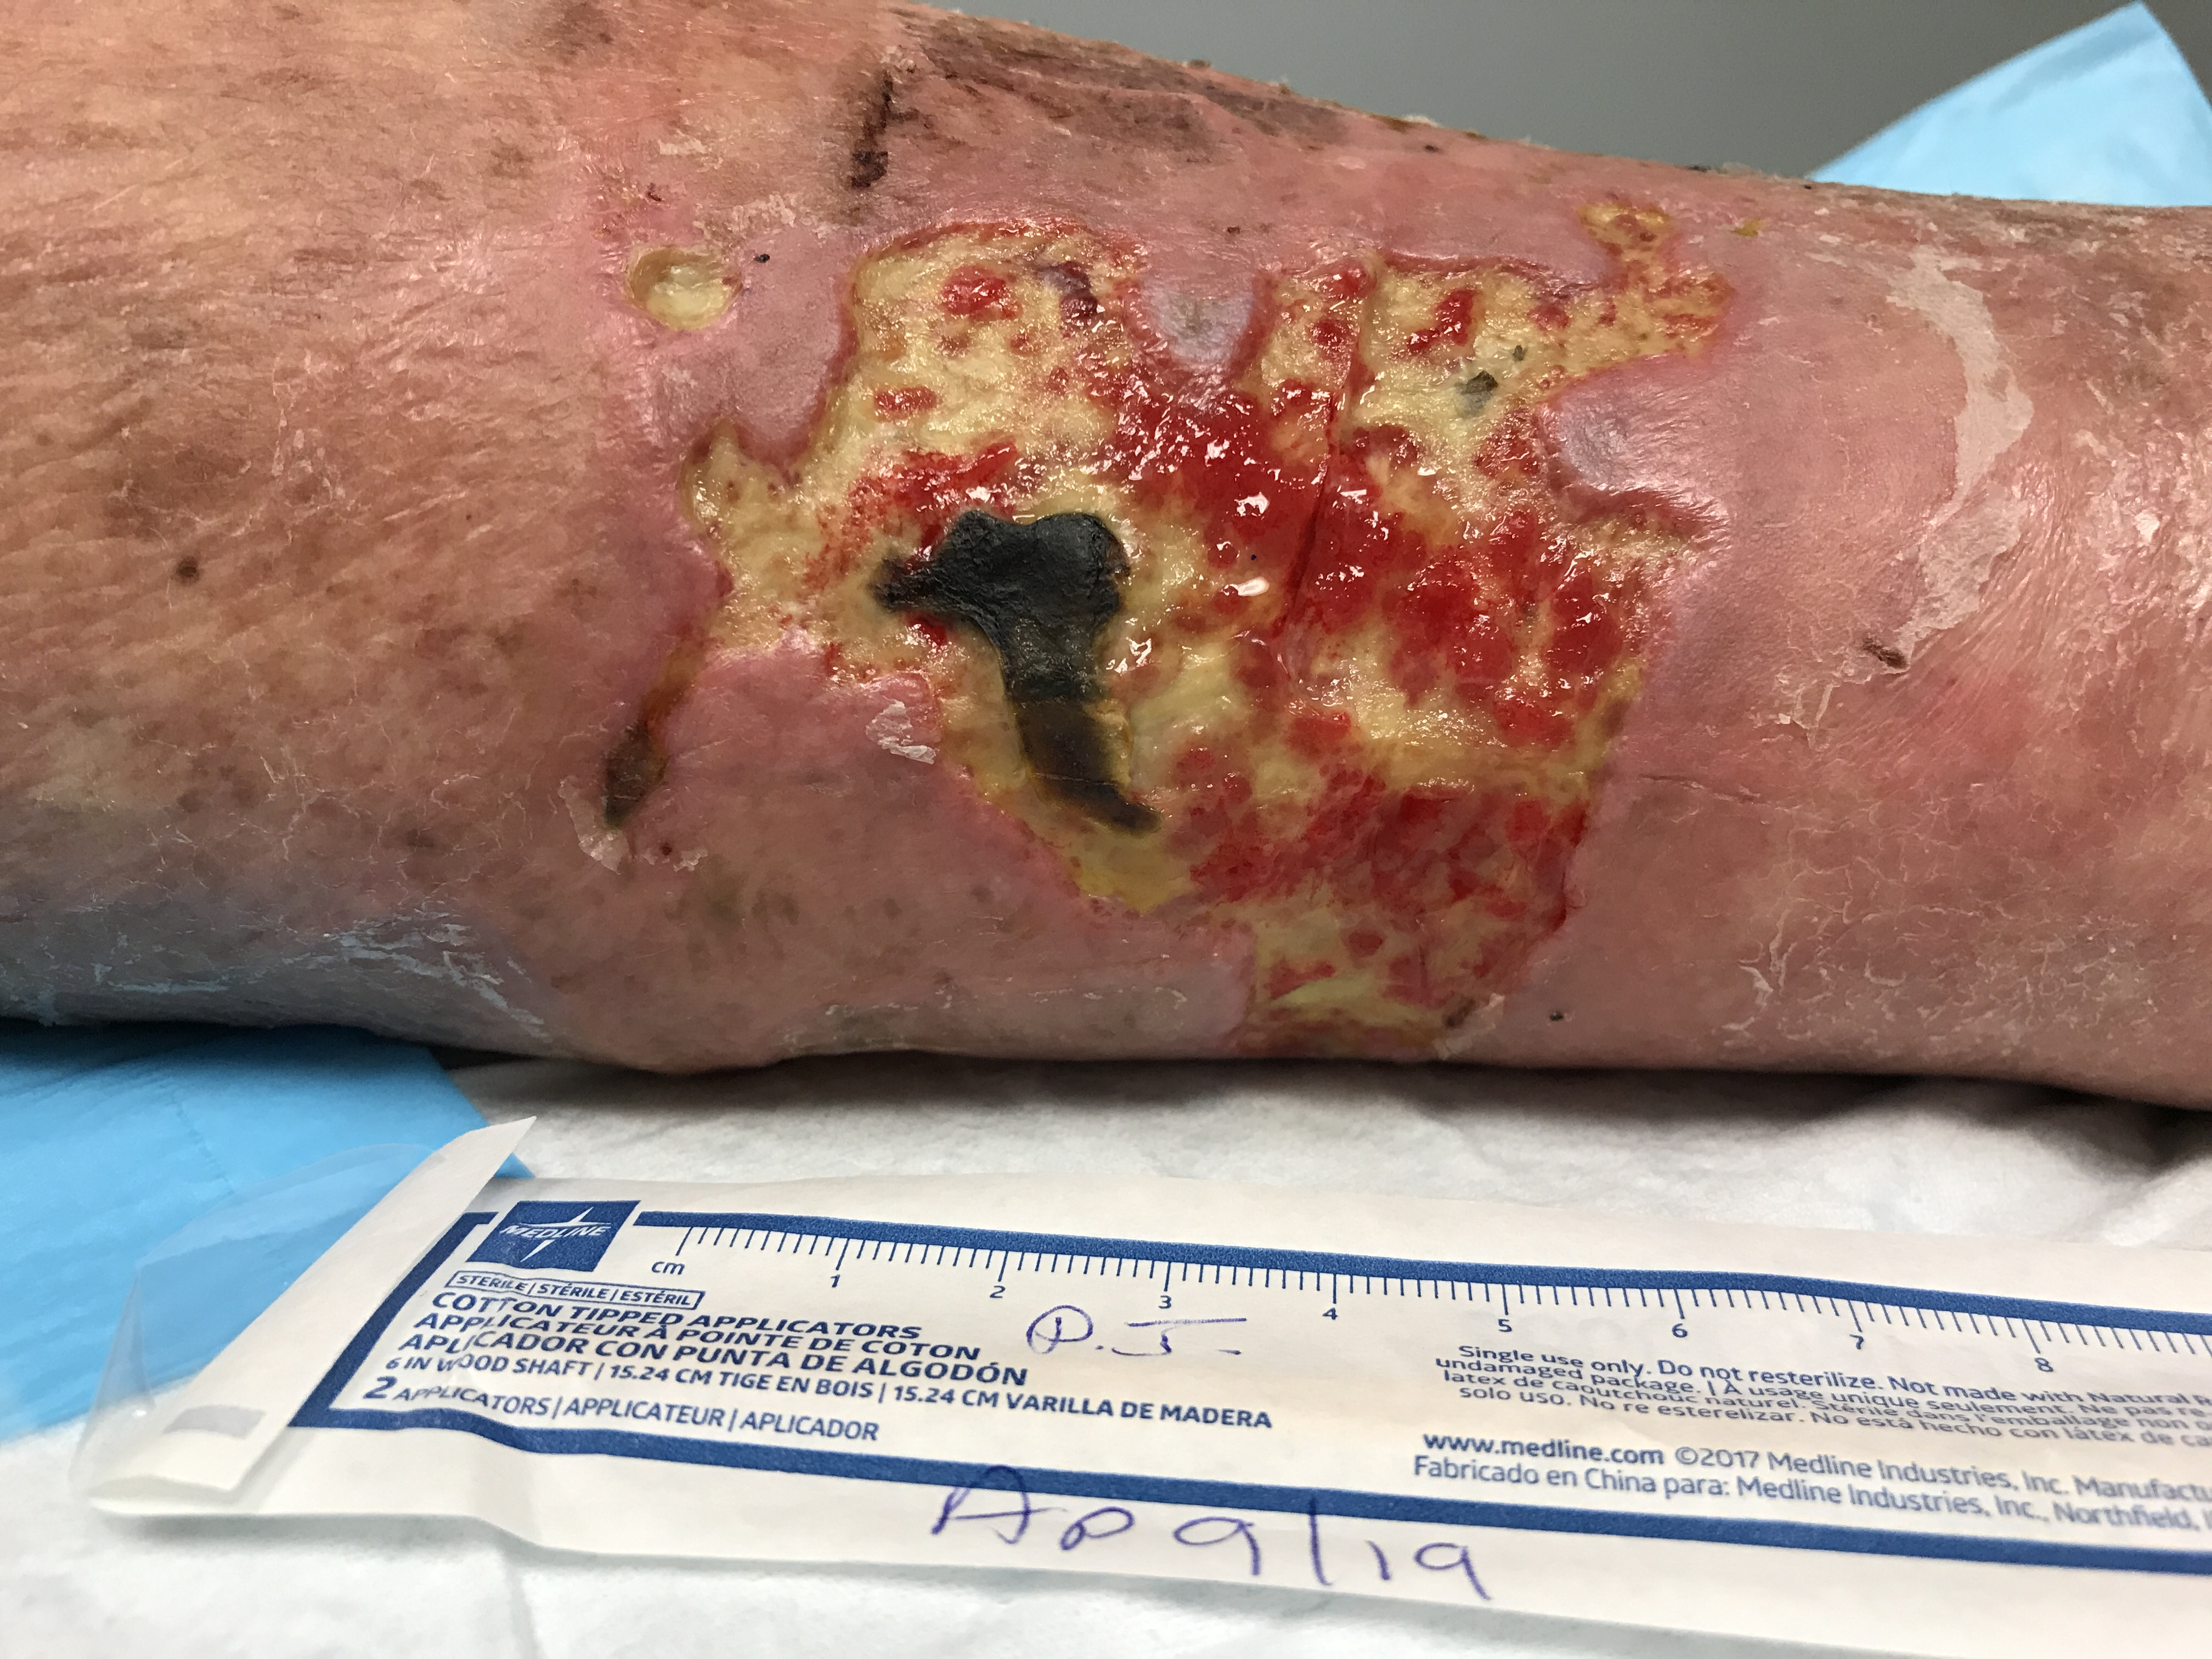
Painful lower leg ulcer
April 9 2020
Patient having extreme leg / wound pain 10/10
Not sleeping well
Feels better when leg is dependent
Wound size increased from 35.75 to 48.75 sqcm
Slough and eschar reducing, eschar becoming less adherent
Some granulation tissue noted
Treatment Plan:
Continuous diffusion of oxygen therapy initiated
2 layer lite compression wraps continued

Slide 5
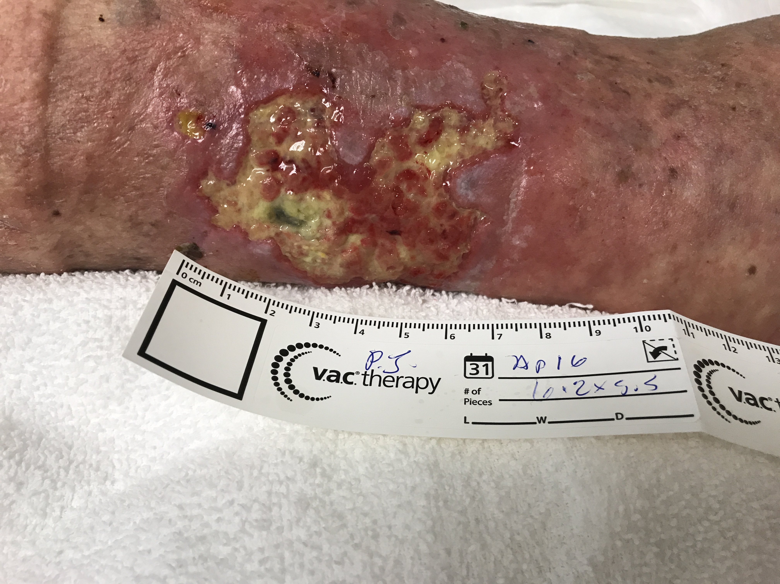
Case Study: Painful lower leg ulcer
April 16
Assessment
Wound slightly smaller
eschar and slough lifting
increased granulation tissue
Pain with dressing change, however overall has decreased to 2/10
Treatment:
Continue with CDO Therapy
2 layer lite compression wraps

Slide 6
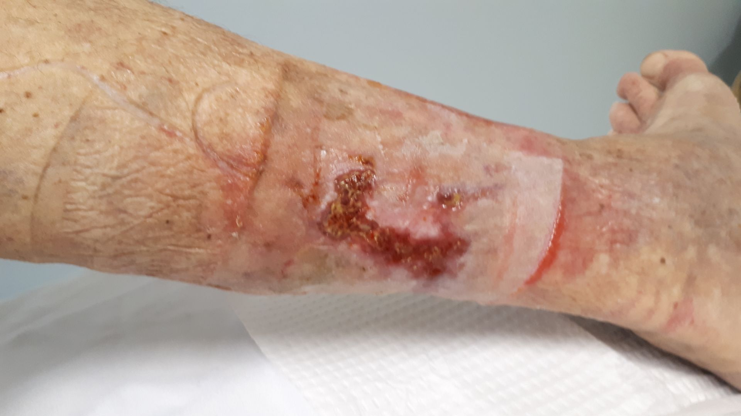
Painful lower leg ulcer
June 4
Assessment
Pain 0/10
Wound healing well continues to decrease in size
No slough or eschar present
EO2 discontinued
Patient wearing compression stockings

Slide 7
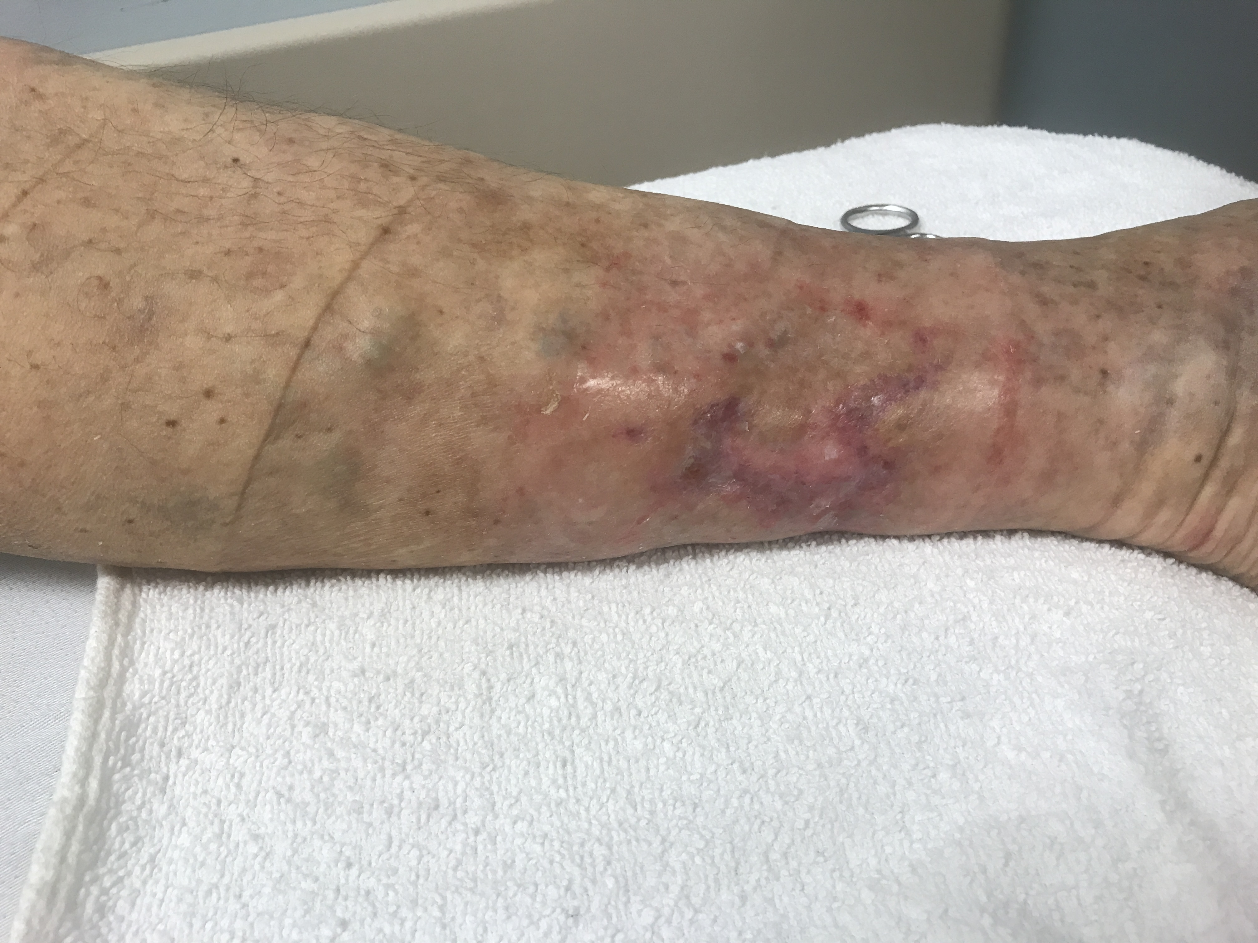
Painful lower leg ulcer
July 11
Wound has closed
Patient reports no pain

Slide 8
TimeLine Re-Cap
January 2020 patient notices a black area on his leg
March 11 initial visit to wound clinic
March 25 missed appointment March 28 wound pain , antimicrobial dressing initiated, compression April 2 wound pain, increasing size, debridement antimicrobial dressing, compression
April 9 CDO initiated
April 16 wound size reducing and pain only with dressing change
June 4 wound continues to heal Healing well. No pain. CDO discontinued
July 11 wound epithelialized, patient remains pain free

